Slide 1
Building Student Confidence in Economics
October 28, 2024
Graham Long
Director of Curriculum & Instruction

Slide 2
Your First Assignment
You are going to build a zoo!
The task (Work with the people around you)
You have 5 minutes
Decide which animals to include in the zoo
You only have 20 hectares of space
Each animal takes up hectares
See next slide

Slide 3
Zoo Animals List
Animal | Number of Hectares Needed
Lion | 3
Turkey | 1/10
Giraffe | 2
Seal | ½
Camel | 2
Cheetah | 1
Cow | 1/3
Monkey | ½
Asian elephant | 1
African elephant | 5
Reptile house | 5
Shark | ½
Kangaroo | 1
Tiger | 1
Whale | 3
House of birds | 5

Slide 4
What Does a Zoo Have to do with Economics?
Students have ideas about what economics is
Students thought that in my economics class they would learn about…
Stocks
How money works
Taxes
Banks

Slide 5
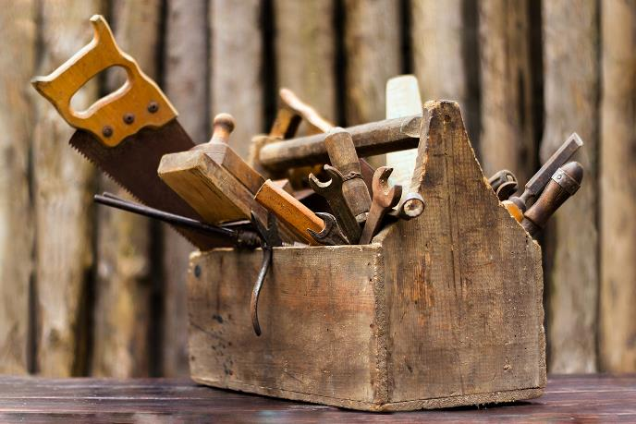
What is Economics?
Those things are important in economics!
But…
We emphasize that economics is a way of thinking
It’s a toolkit

Slide 6
What the Zoo Activity Teaches
Why did you try to create the best zoo possible?
Incentives
(You all are incentivized to make the best zoo possible)

Slide 7
What the Zoo Activity Teaches
Why didn’t you put one of every animal in the zoo?
Scarcity
(The amount of space was limited)

Slide 8
What the Zoo Activity Teaches
Why didn’t you put ________________ in your zoo?
Costs vs Benefits
(You had to weigh the benefits of putting a particular animal in, vs the costs associated with it)

Slide 9
What the Zoo Activity Teaches
Was their discussion in your group about the best animals to include?
Individual benefits vs
Societal benefits
(There is sometimes tension between what is best for you vs
what is best for the group)

Slide 10
What the Zoo Activity Teaches
Students think economics is all about money and finance and math
And those things are important concepts
But we try to teach that economics is a social science
It studies…
Human behavior
Human choices

Slide 11
Your Students ARE Economists!
And the great thing is, your students already understand a lot more economics than they realize!
Think about the Zoo Activity:
Students understood they had limited space (scarcity)
Students understood they had to choose some animals (costs vs benefits/trade-offs)
Your students already know economics!
That’s exciting, because you want them to feel empowered and to have belief

Slide 12
Your Students ARE Economists!
Our task is to get students to make the connection between what they already understood (the Zoo Activity) with the “real world”
Examples
Limited hectares in zoo activity
Students learn scarcity
Students apply it to fiscal policy (example: government budgets)

Slide 13
Your Students ARE Economists!
Examples
Students weighed the costs and benefits of putting an animal in the zoo
Students learn the term trade-offs
Students apply trade-offs to public policy (example: what are the costs and benefits of a transition away from fossil fuels)

Slide 14
Some of the Ways We Build Student Confidence
Presenting on Issues Students Care About
We ask students to research issues in their community and use the tools of economics to examine them:
How can the state of New York transition to using clean energy?
What incentives can we offer to improve the number of primary care physicians in New York City?
How does a student’s neighborhood affect their education outcomes?

Slide 15
Some of the Ways We Build Student Confidence
Presenting Economics in a New Way
We have a program where students write podcast scripts about economic issues they care about.

Slide 16
Some Resources for You
We have economics comic books. In Spanish!

Slide 17
Thank you!
Graham.C.Long@ny.frb.org

