Slide 1
You are the Economy
Economics education from the Bank of Canada Museum
Adam Young, Education & Evaluation Specialist
Notes:
Welcome! In the chat would you tell me what you’re teaching? Any connections to economics? Have you been to the Museum before or seen our resources online?

Slide 2
Land Acknowledgement
We would like to begin by acknowledging that we are meeting on the land of the First Nations, Inuit and Métis. We pay our respect to Indigenous Peoples across the country and to their ancestors for their immeasurable contributions to this country.
Notes:
This eagle feather is on the $10 vertical series note. For many First Nations peoples in Canada, the eagle is believed to fly higher and see further than any other bird, and an eagle feather symbolizes ideals such as truth, power and freedom. It is intended to represent the ongoing journey toward recognizing rights and freedoms for Indigenous Peoples in Canada.

Slide 3
The Bank of Canada
The central bank of Canada, opened in 1935.
Mandate is to support the economic and financial welfare of Canada
This Photo by Unknown Author is licensed under CC BY-ND

Slide 4
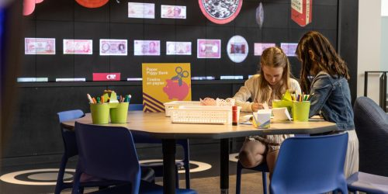
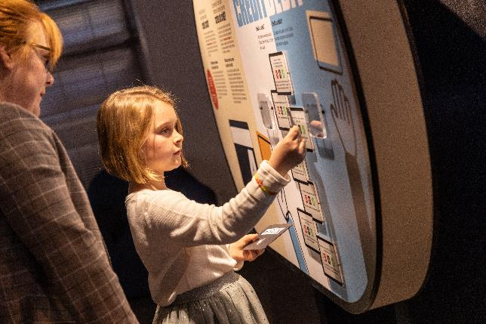
Notes:
Formerly currency Museum- in Ottawa, demystify the role of the Bank of Canada and the Canadian economy. Hyper interactivity

Slide 5
The Bank of Canada Museum
Canada’s only economics and money museum
Completely renovated and renewed in 2017
Located at the Bank of Canada in Ottawa
Home of the National Currency Collection: over 100,000 artifacts of currency and trade items.
Virtual school program for Kindergarten to Grade 5
Onsite school programs for Grades 4-12
Free to the public

Slide 6
Online Resources
Lesson plans, videos, games and activities to explore:
• The history of money and trade in Canada
• Symbolism and portraits on Canadian bank notes
• Saving and spending
• Fiscal and monetary policy
• Money and mathematics for elementary years
www.bankofcanadamuseum.ca/learn

Slide 7
You are the Economy
Educational resource
a web-based educational resource that explores the role of the Bank of Canada and key Canadian economic concepts for high school students.
The target audience is students from grades 7-12 across Canada in economics, business, careers, social studies and health classes.
An à la carte resource for teachers, with the flexibility to choose the lessons and activities best suited for individual grades, subjects, and curricular outcomes.

Slide 8
Student outcomes:
Recognize the economics around them and understand their key concepts such as supply and demand, tradeoffs, etc.
Connect the role and functions of the Bank of Canada to the wider society.
Appraise their current and future role within the economy.
Develop economic skills: think critically, assess risk, draw conclusions from data and information to make the best choice.
Develop a general sense of trends seen in news articles on the economy and business.

Slide 9
Adaptations
Differentiation
Connection to the Bank of Canada
Diverse curriculum
Help to see the big picture
Adaptable to ages & grades
Links to external supports
Second language learners
Keeping information evergreen

Slide 10
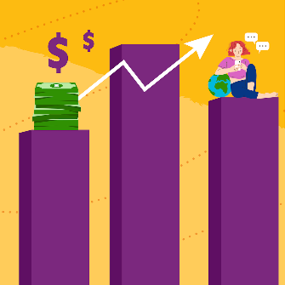
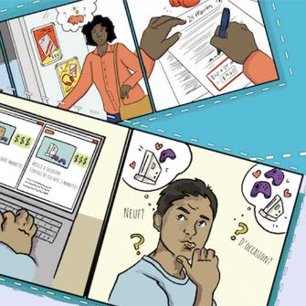
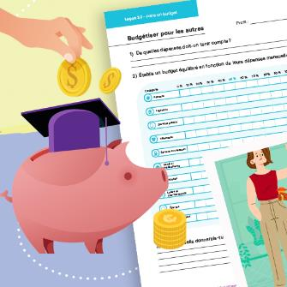
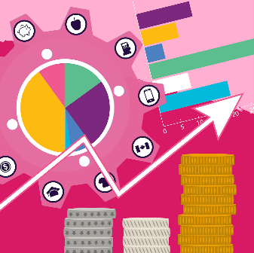
Lesson by lesson
Building budgets
income and expenses for your future, and for a fictional character
Illustrating Canada’s place in the world
trade, immigration, GDP and investment using a data visualization tool
Investing in a better world
Roleplay for investment factors and scenarios
Think like an economist
economic situations throughout your life and everywhere around you
Decoding Canadian economic data
Interpreting current and historical economic data
Connecting Canadian industries
using industry summaries to explain the wider economy

Slide 11
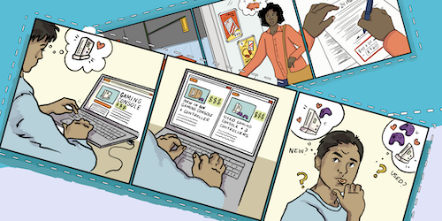
It’s Personal: Economics 101
Thinking like an economist
Building budgets

Slide 12
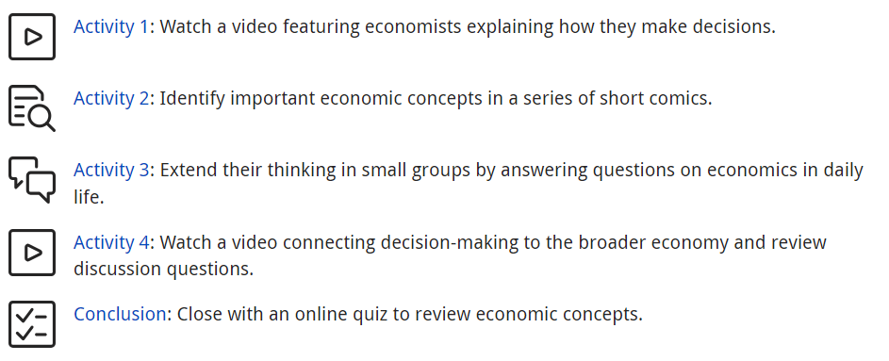
Thinking like an economist

Slide 13
BOCM

Slide 14
Can you identify any economic concepts?

Slide 15
Can you identify any economic concepts?
opportunity cost
sunk cost

Slide 16
Can you identify any economic concepts?

Slide 17
Can you identify any economic concepts?
competition
utility
marginal utility

Slide 18
Can you identify any economic concepts?

Slide 19
Can you identify any economic concepts?
trade-offs
externalities
subsidies

Slide 20
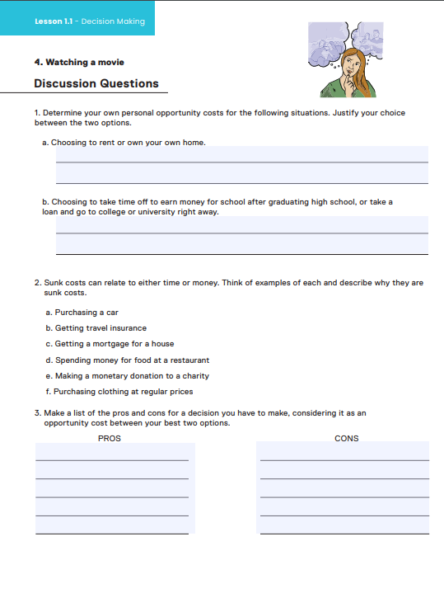
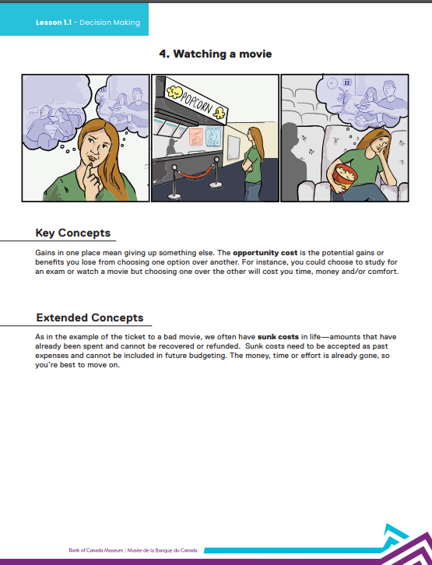
Station worksheets

Slide 21
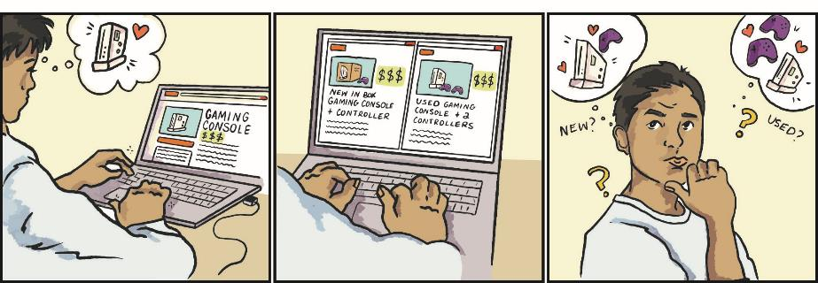
The series of comics

Slide 22
Economic terms
Sunk costs
Trade-offs
Depreciation
Competition
Inelastic and elastic demand
Debt
Externalities
Interest
Imports and exports
Supply and demand
Incentives
Marginal utility
Inflation
Loan
Subsidy
Disincentives
Opportunity cost
Money
Barter system
Markets
Utility
Currency
Deflation

Slide 23
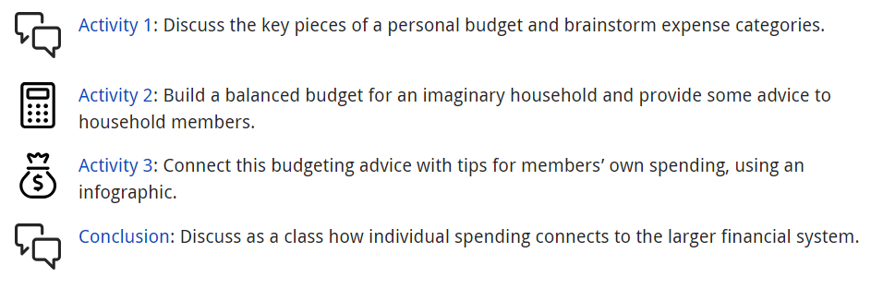
Building budgets​

Slide 24
Budgeting profiles
Two parents, two kids
Intergenerational family
Couple with pets

Slide 25
Budgeting profiles
Single dad
University student
Senior

Slide 26
Budgeting worksheet

Slide 27
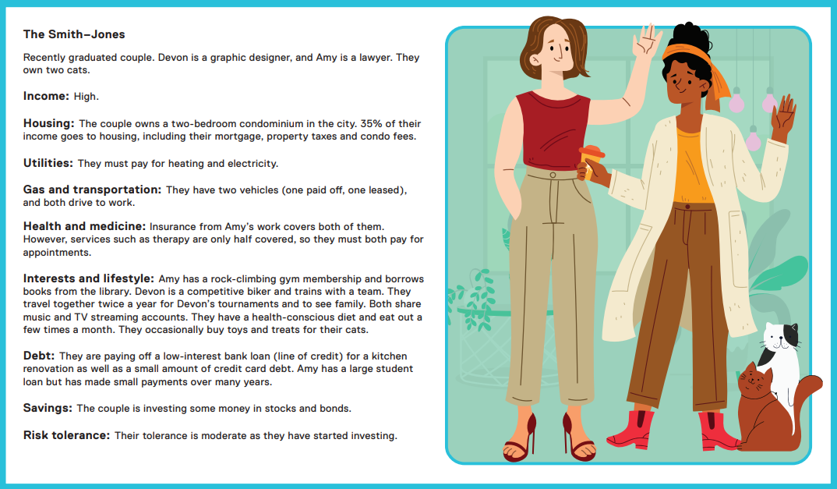
What budgeting advice would you give?

Slide 28
Budgeting infographic

Slide 29
Budgeting infographic

Slide 30
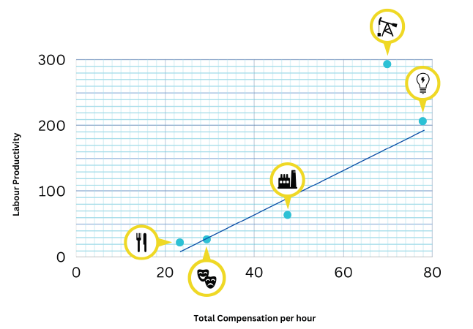
On target: Canadian economy
Connecting Canadian industries
Decoding Canadian economic data

Slide 31
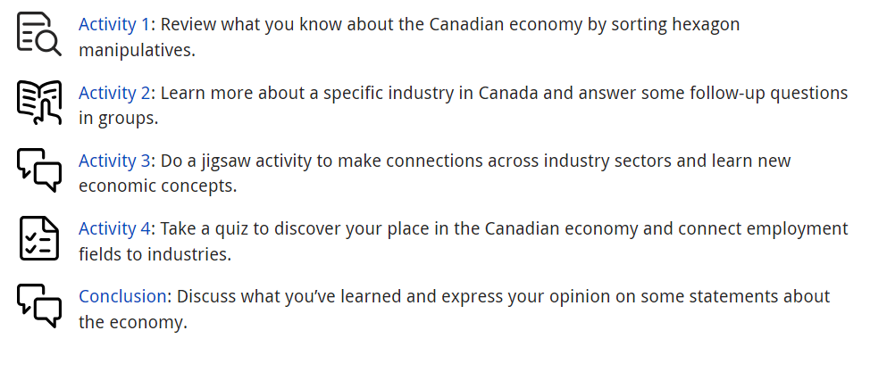
Connecting Canadian industries​

Slide 32
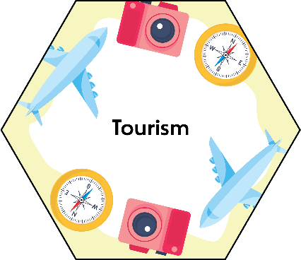
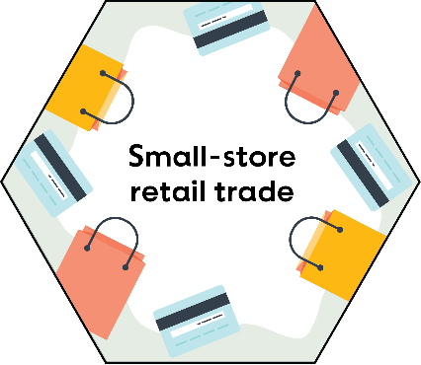

Slide 33
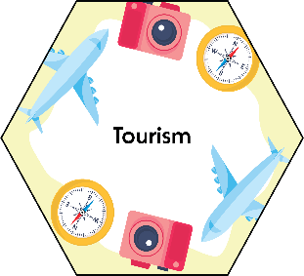
Can you sort the industry hexagons by total GDP contribution? (largest to smallest)

Slide 34
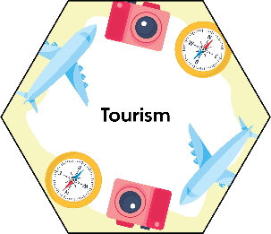
Can you sort the industry hexagons by total
number of employees? (largest to smallest)

Slide 35
Connecting industries worksheet

Slide 36
Decoding Canadian economic data​

Slide 37
Graph Part 1

Slide 38
Graph Part 2

Slide 39
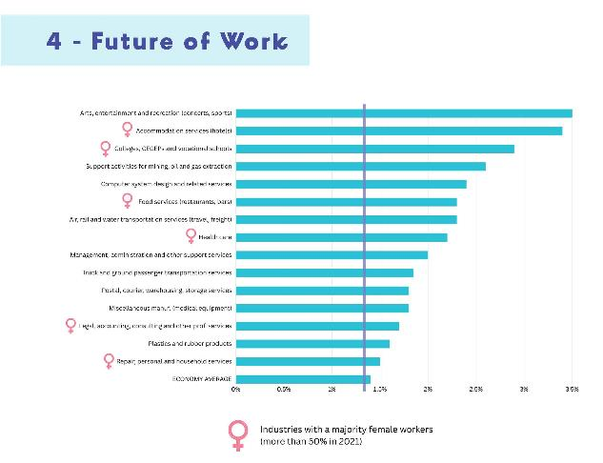
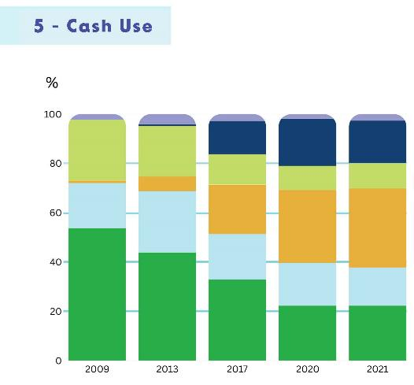
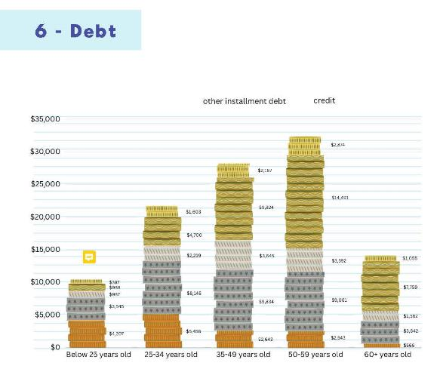
More examples

Slide 40
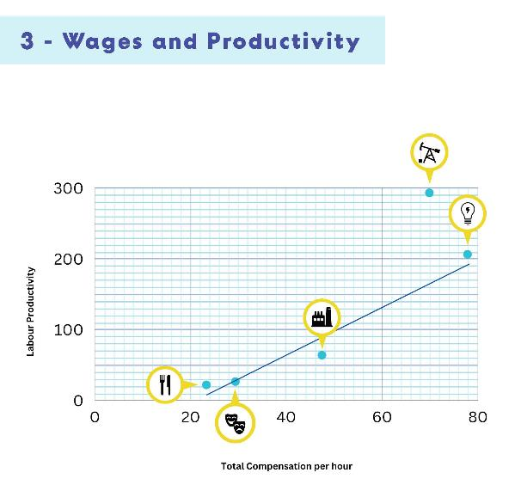
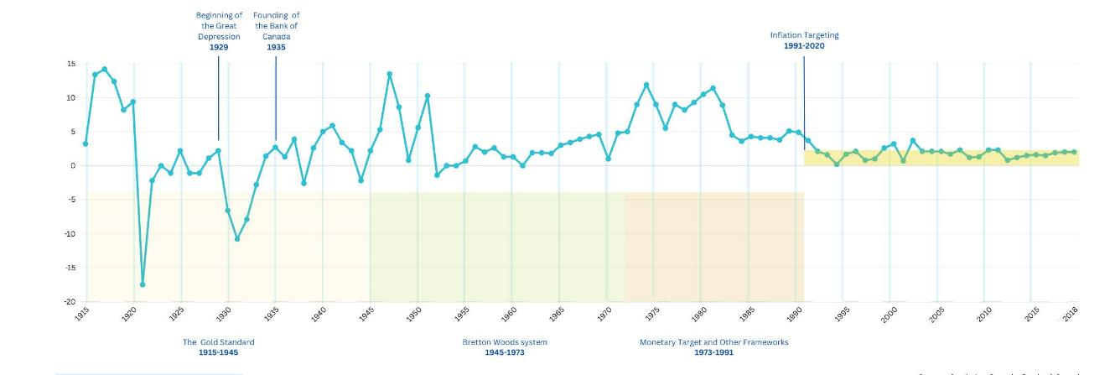
More examples

Slide 41
Us and the world: Global economy
Visualizing Canada’s place in the world
Investing in a better world

Slide 42
The final two lesson plans
Visualizing Canada’s place in the world
Start with an online quiz to assess background knowledge
Use the global map interactive to answer thematic questions
Do a three-step interview with a De Bono’s thinking hats question per theme.
Investing in a better world
Brainstorm ways that individuals and companies invest
Sort factors most important to you in investing
Determine in small groups a company you’d want to invest in based on role cards

Slide 43
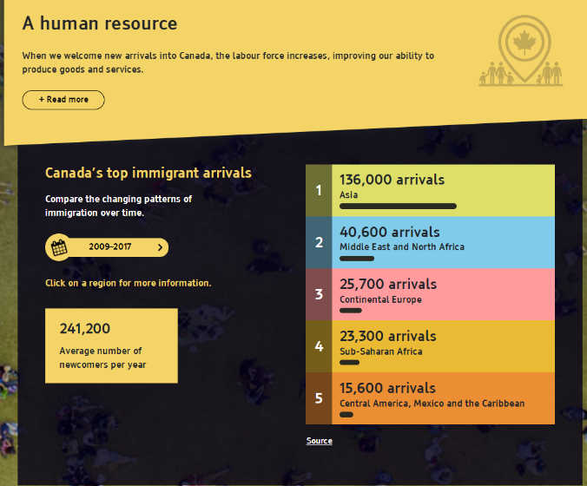
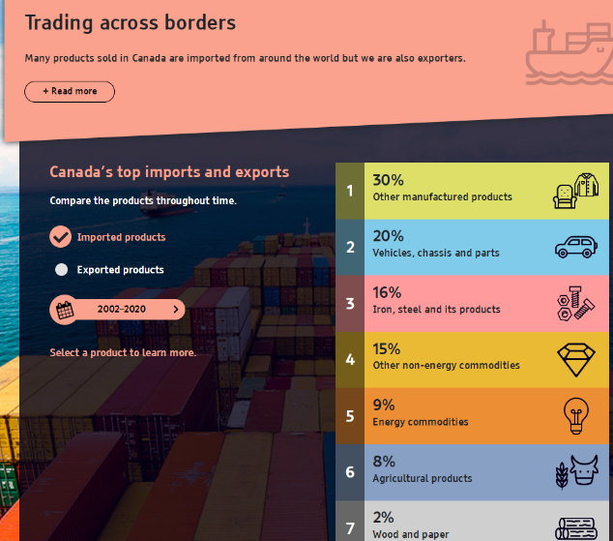
Visualizing Canada’s place in the world ​
Uses an online data tool with questions to answer across four topics.
Worksheet with questions to Validate data, connect to historical markers and moments.

Slide 44
Investing in a better world​
Choosing between four fictional shoe companies to invest in,
But global events get in the way:
Supply chain challenges
Labour unrest and strikes
Public scandals
Greenwashing unearthed
Foreign exchange rate shifts

Slide 45
Lessons learned
Keep things interactive with games, simulations, and big discussions.
Find entry points with everyday examples that connect to students’ lives.
Provide the tools to support decision-making.
Don’t let numbers and math always drive the discussion or work.

Slide 46
Thank you
Adam Young
yoad@bank-banque-canada.ca
www.bankofcanadamuseum.ca/learn

